Slide 1
Unit 5 - Lecture 31
Inductive learning
Decision tree learning

Slide 2
Inductive learning
In supervised learning, the learning element is given the correct (or approximately correct) value of the function for particular inputs, and changes its representation of the function to try to match the information provided by the feedback.
More formally, we say an example is a pair (x,f(x)), where x is the input and f(x) is the output of the function applied to x.
The task of pure inductive inference (or induction) is this: given a collection of examples of f, return a function h that approximates f. The function h is called a hypothesis.
Figure in next shows an example of this from plane geometry.
The examples in Figure (a) are (x,y) points in the plane, where y = f(x), and the task is to find a function h(x) that fits the points well.

Slide 3
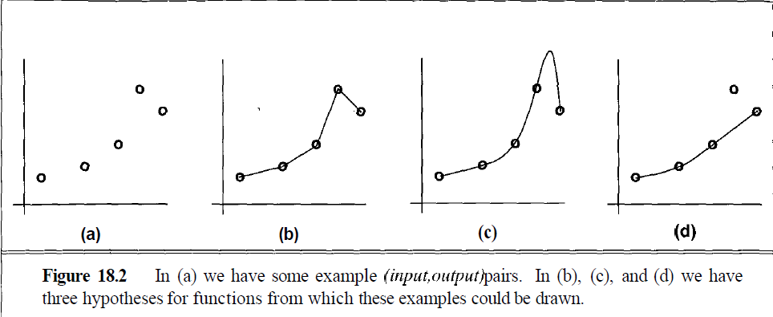

Slide 4
In Figure (b) we have a piecewise-linear h function, while in Figure (c) we have a more complicated h function.
Both functions agree with the example points, but differ on the y values they assign to other x inputs.
In (d) we have a function that apparently ignores one of the example points, but fits the others with a simple function.
The true f is unknown, so there are many choices for h, but without further knowledge, we have no way to prefer (b), (c), or (d).
Any preference for one hypothesis over another, beyond mere consistency with the examples, is called a bias.
Because there are almost always a large number of possible consistent hypotheses, all learning algorithms exhibit some sort of bias.

Slide 5
Suppose we have a reflex agent that is being taught by a teacher.
Figure in next slide shows that the REFLEX-LEARNING-ELEMENT updates a global variable, examples, that holds a list of (percept, action) pairs.
The percept could be a chess board position, and the action could be the best move as determined by a helpful grandmaster.
When the REFLEX-PERFORMANCE-ELEMENT is faced with a percept it has been told about, it chooses the corresponding action.
Otherwise, it calls a learning algorithm INDUCE on the examples it has seen so far.
INDUCE returns a hypothesis h which the agent uses to choose an action.

Slide 6
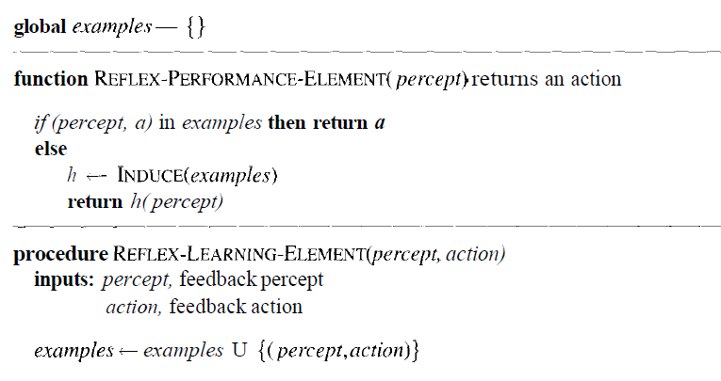

Slide 7
There are many variants on this simple scheme.
For example, the agent could perform incremental learning: rather than applying the learning algorithm to the entire set of examples each time a new prediction is needed, the agent could just try to update its old hypothesis whenever a new example arrives.
Also, the agent might receive some feedback concerning the quality of the actions it chooses.
REFLEX-PERFORMANCE-ELEMENT makes no commitment to the way in which the hypothesis is represented.
Because of its expressiveness and well-understood semantics, logic has been intensively studied as the target language for learning algorithms.

Slide 8
Decision tree learning
In this unit, we will discuss an approach to learn logical sentences: decision tree method
Decision tree is the most powerful and popular tool for classification and prediction.
A Decision tree is a flowchart like tree structure, where each internal node denotes a test on an attribute, each branch represents an outcome of the test, and each leaf node (terminal node) holds a class label.

Slide 9
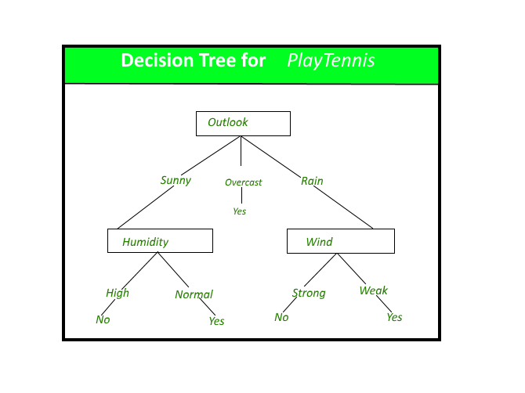

Slide 10
Construction of Decision Tree
A tree can be “learned” by splitting the source set into subsets based on an attribute value test.
This process is repeated on each derived subset in a recursive manner called recursive partitioning.
The recursion is completed when the subset at a node all has the same value of the target variable, or when splitting no longer adds value to the predictions.
The construction of decision tree classifier does not require any domain knowledge or parameter setting, and therefore is appropriate for exploratory knowledge discovery.
Decision trees can handle high dimensional data. In general decision tree classifier has good accuracy.
Decision tree induction is a typical inductive approach to learn knowledge on classification.

Slide 11
Decision Tree Representation
Decision trees classify instances by sorting them down the tree from the root to some leaf node, which provides the classification of the instance.
An instance is classified by starting at the root node of the tree, testing the attribute specified by this node, then moving down the tree branch corresponding to the value of the attribute as shown in the slide 12 figure.
This process is then repeated for the subtree rooted at the new node.
The decision tree in figure classifies a particular morning according to whether it is suitable for playing tennis and returning the classification associated with the particular leaf.(in this case Yes or No).

Slide 12
For example, the instance
(Outlook = Rain, Temperature = Hot, Humidity = High, Wind = Strong )
would be sorted down the leftmost branch of this decision tree and would therefore be classified as a negative instance.
In other words we can say that decision tree represent a disjunction of conjunctions of constraints on the attribute values of instances.
(Outlook = Sunny ^ Humidity = Normal) v (Outllok = Overcast) v (Outlook = Rain ^ Wind = Weak)

Slide 13
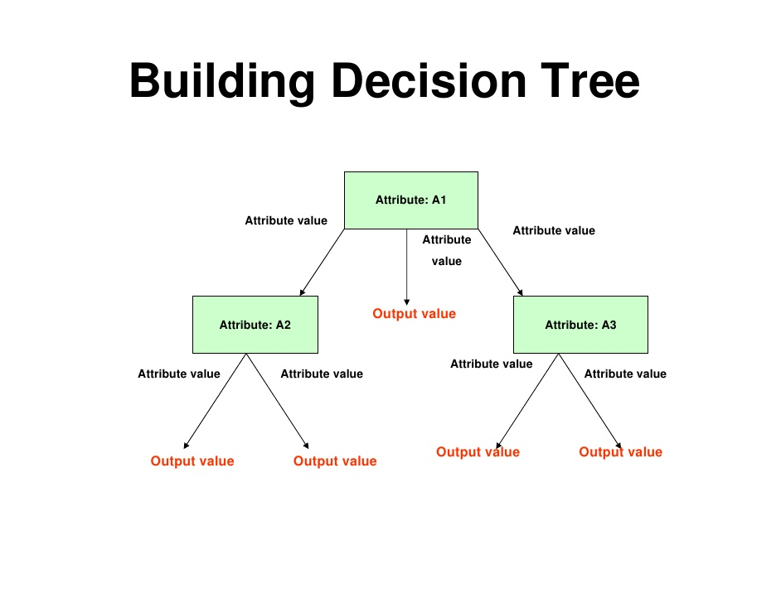

Slide 14
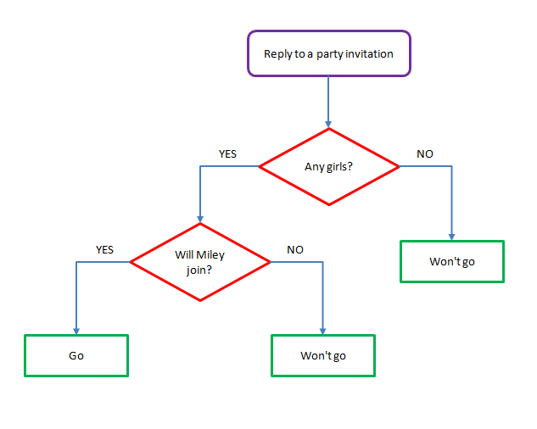

Slide 15
Strength of decision tree learning
Decision trees are able to generate understandable rules.
Decision trees perform classification without requiring much computation.
Decision trees are able to handle both continuous and categorical variables.
Decision trees provide a clear indication of which fields are most important for prediction or classification.

Slide 16
Weaknesses of decision tree learning
Decision trees are less appropriate for estimation tasks where the goal is to predict the value of a continuous attribute.
Decision trees are prone to errors in classification problems with many class and relatively small number of training examples.
Decision tree can be computationally expensive to train. The process of growing a decision tree is computationally expensive. At each node, each candidate splitting field must be sorted before its best split can be found. In some algorithms, combinations of fields are used and a search must be made for optimal combining weights. Pruning algorithms can also be expensive since many candidate sub-trees must be formed and compared.

Slide 17
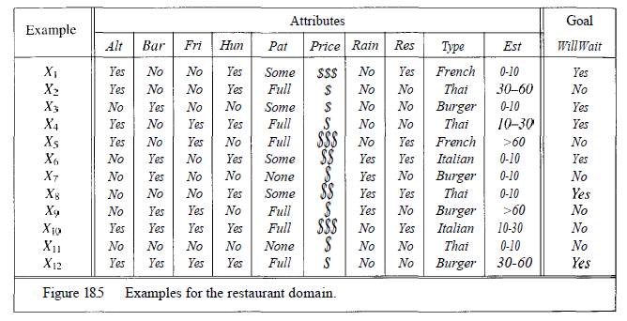

Slide 18
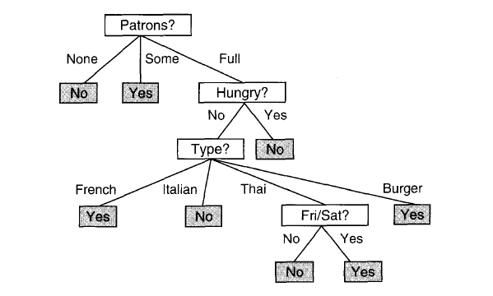

Slide 19
